Slide 1
Design and Analysis of Algorithms
Lecture 03
Binary Trees, AVL Trees and Heaps

Slide 2
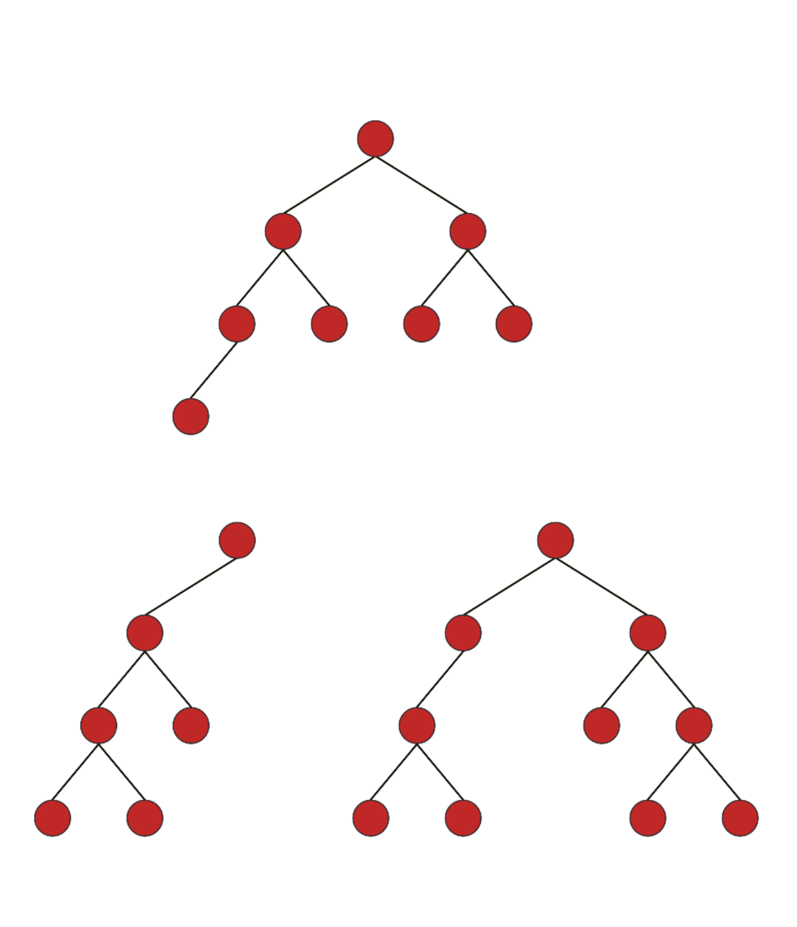

Slide 3
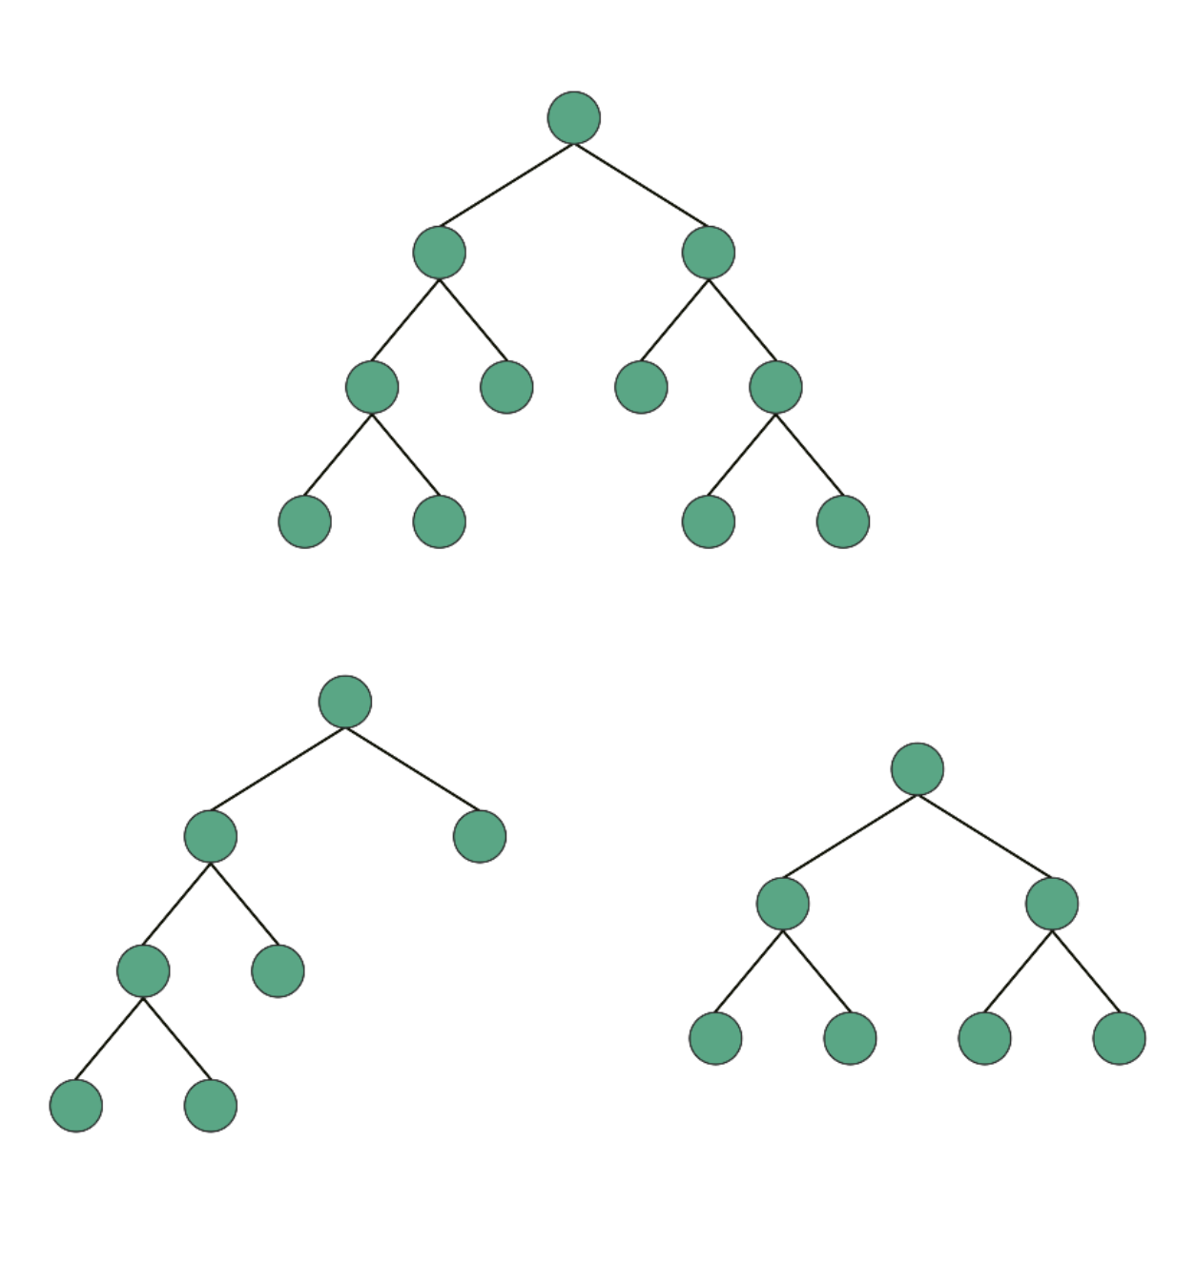

Slide 4
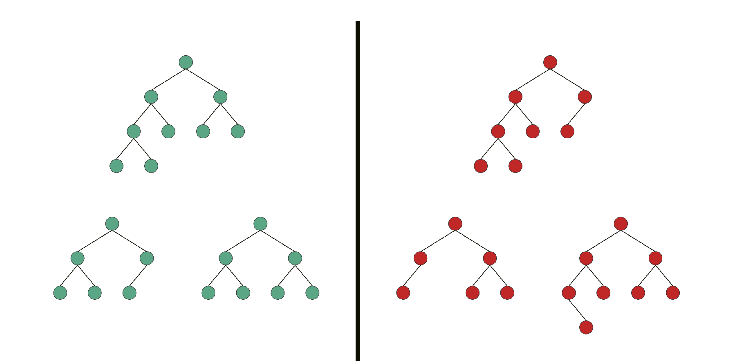

Slide 5
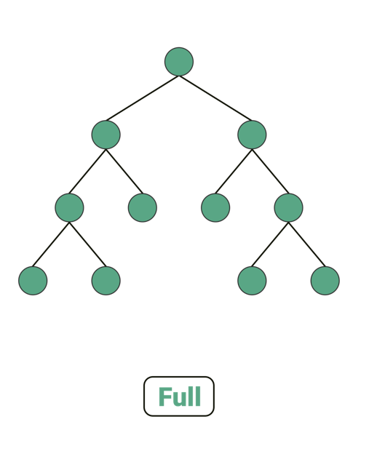

Slide 6
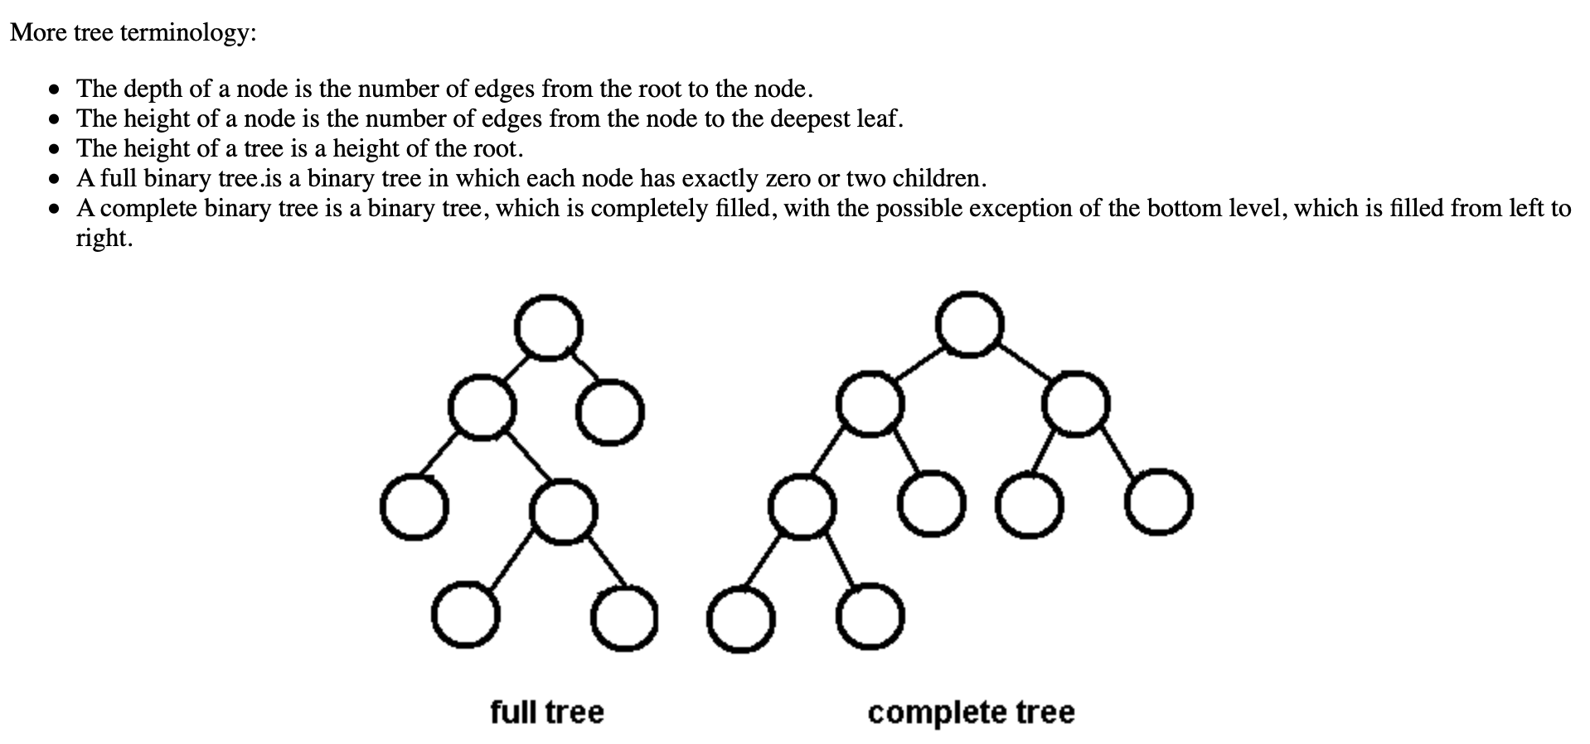

Slide 7
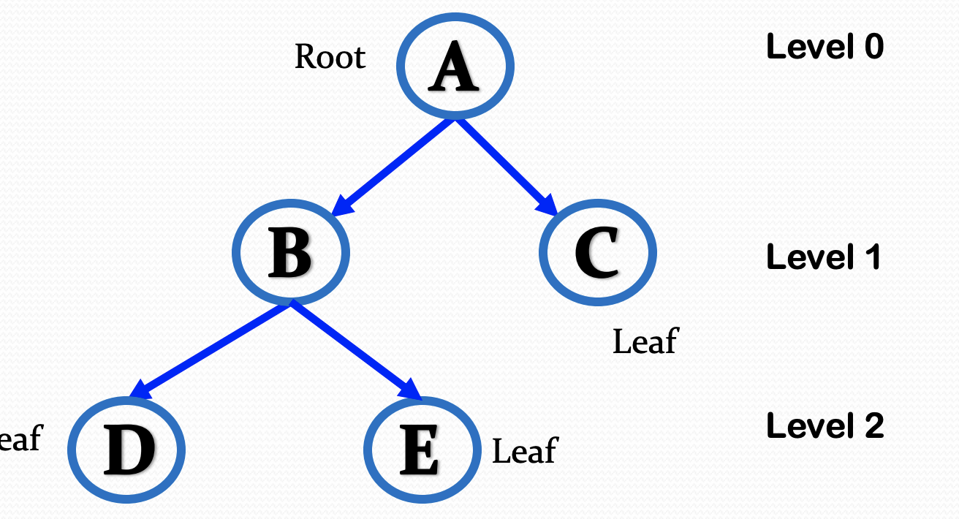
Trees
A tree is a hierarchical representation of a finite set of one or more data items such that:

Slide 8
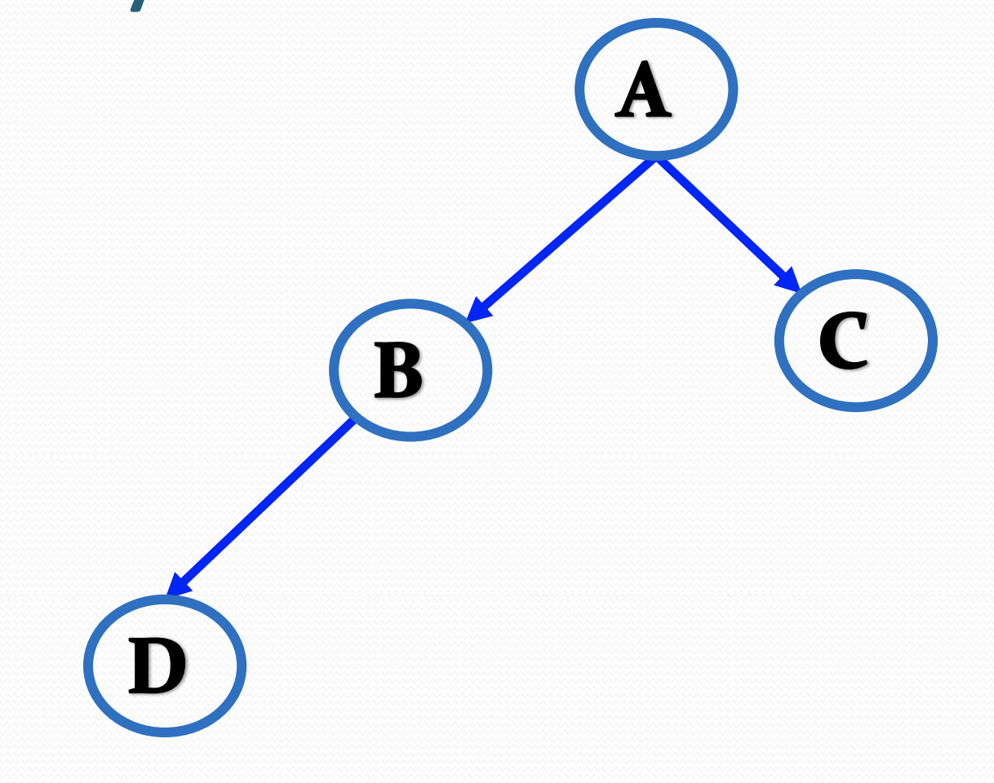
Binary Trees
Binary Tree is a rooted tree in which root can have maximum two children such that each of them is again a binary tree. That means, there can be 0,1, or 2 children of any node.

Slide 9
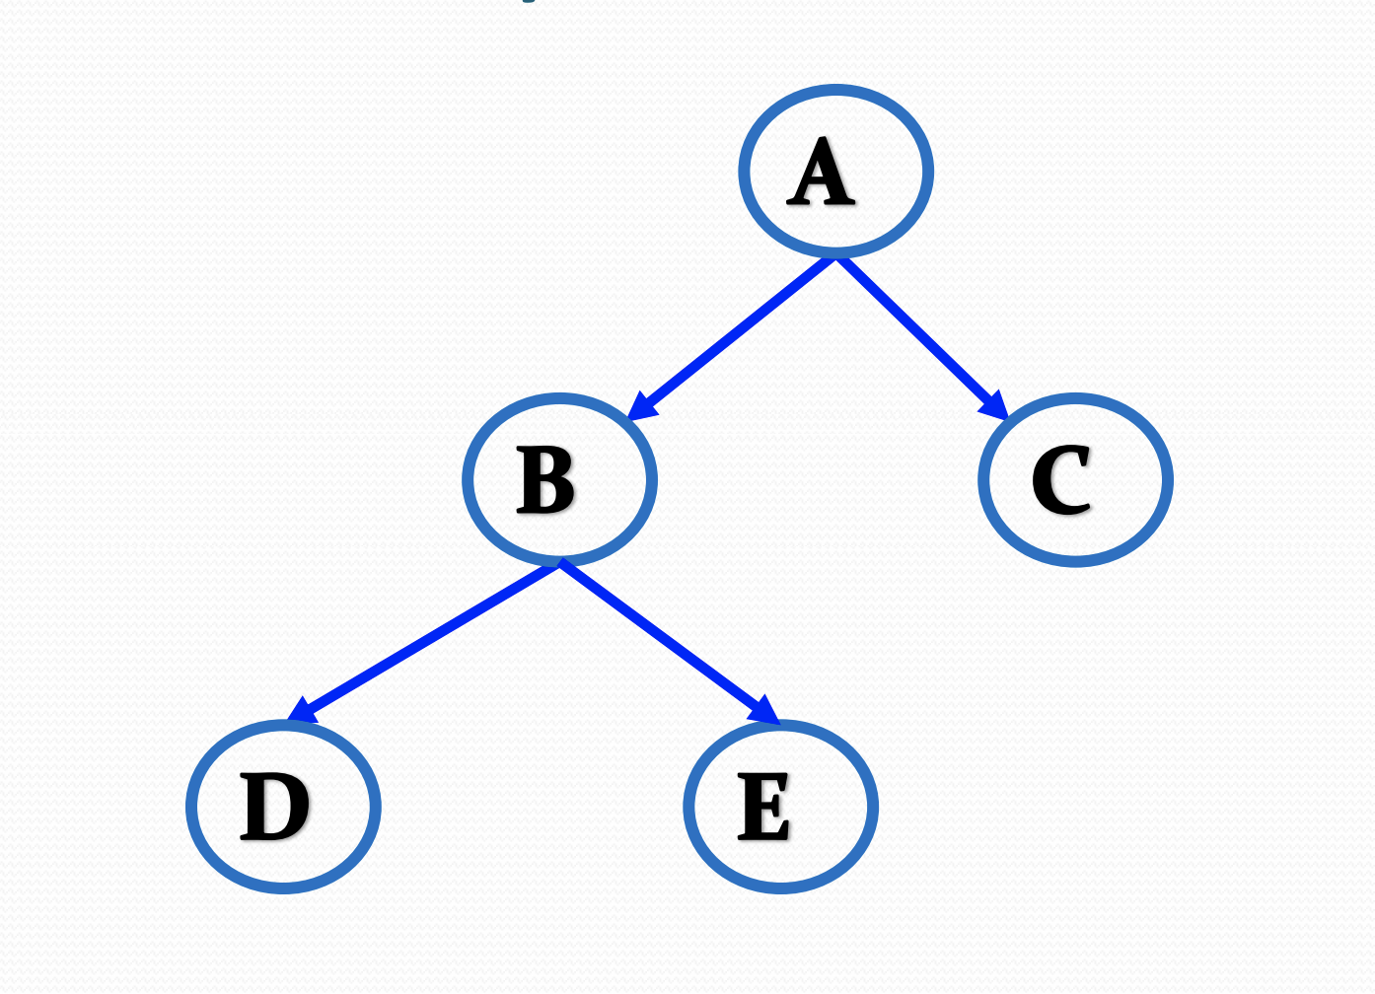
Strict Binary Tree
Strict Binary Tree is a Binary tree in which root can have exactly two children or no children at all. That means, there can be 0 or 2 children of any node.

Slide 10
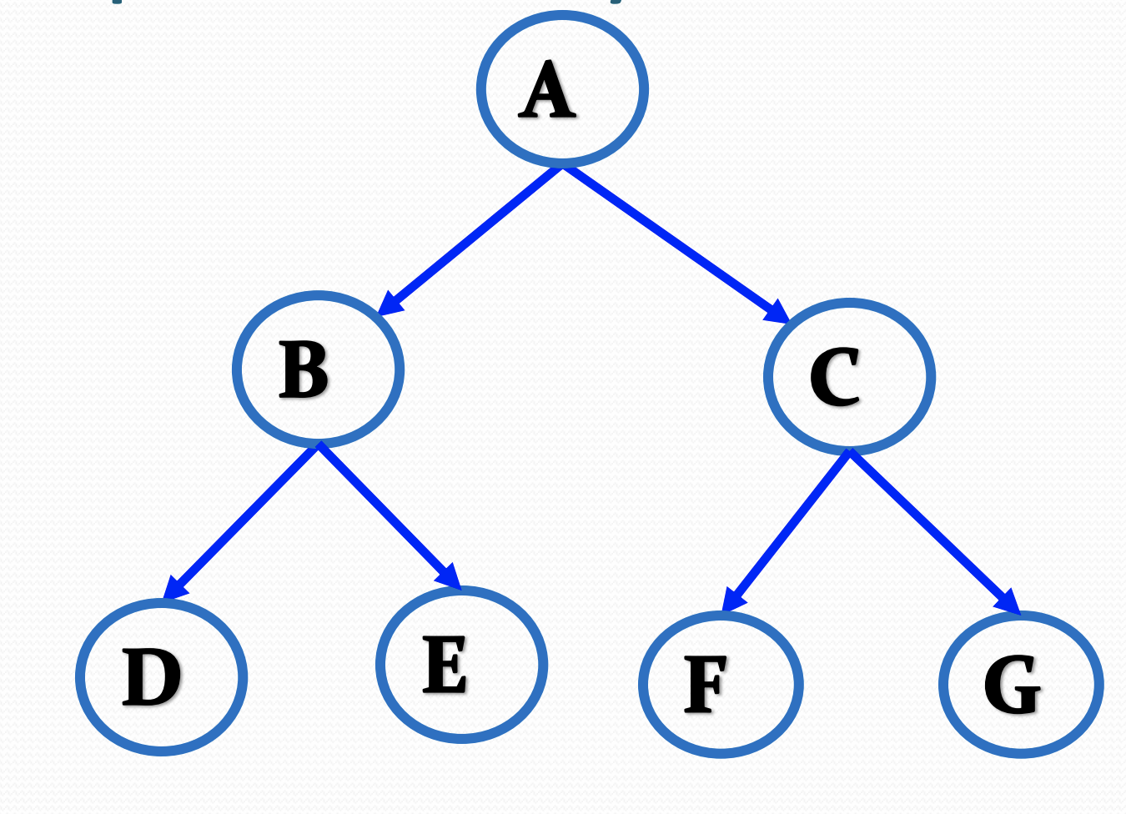
Full Binary Tree
A full binary tree (sometimes proper binary tree or 2-tree) is a tree in which every node other than the leaves has two children.

Slide 11
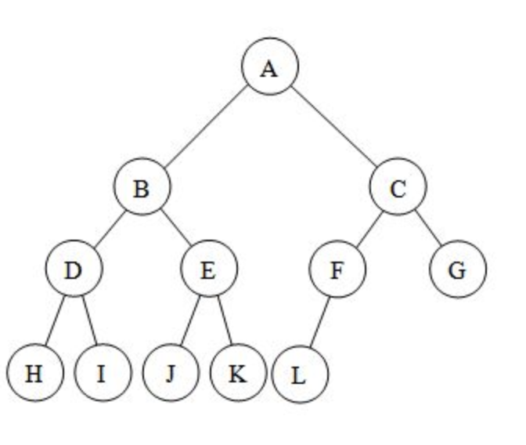
Complete Binary Tree
Complete Binary Tree is a Strict Binary tree in which every leaf node is at same level. That means, there are equal number of children in right and left subtree for every node.

Slide 12
Binary Tree Representation
Array representation
Parent Node is at index ➔ r
Left child is at ➔ 2* r + 1
Right child is at ➔ 2* r + 2
Parent of a child ===➔ ( r -1 ) / 2

Slide 13
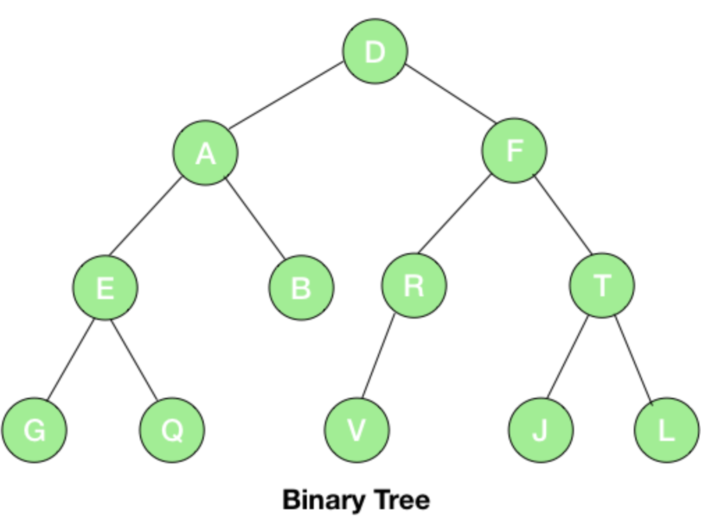
0 | 1 | 2 | 3 | 4 | 5 | 6 | 7 | 8 | 9 | 10 | 11 | 12 | 13 | 14
D | A | F | E | B | R | T | G | Q | - | - | V | - | J | L

Slide 14
0 | 1 | 2 | 3 | 4 | 5 | 6 | 7 | 8 | 9 | 10 | 11
0 | 1 | 2 | 3 | 4 | 5 | 6 | 7 | 8 | 9 | 10 | 11

Slide 15
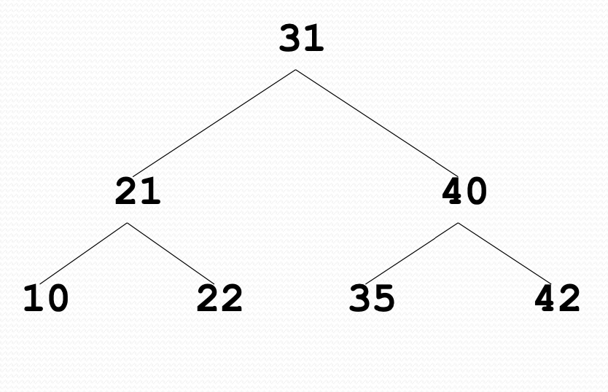
Binary Search Tree
The value at any node,
Greater than every value in left subtree
Smaller than every value in right subtree
Values in left sub tree less than parent
Values in right sub tree greater than parent

Slide 16
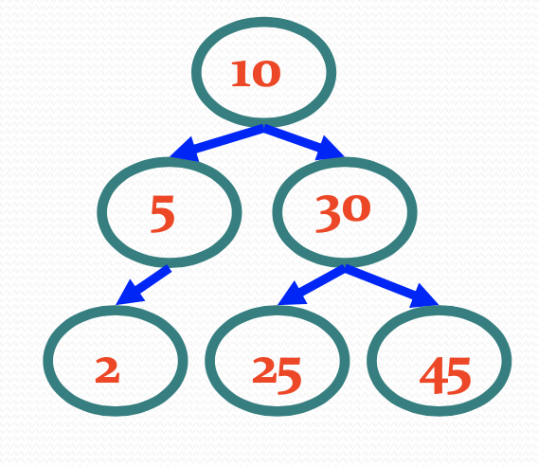
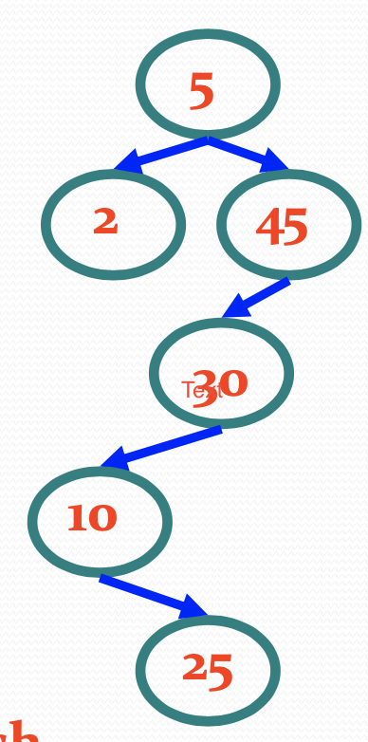
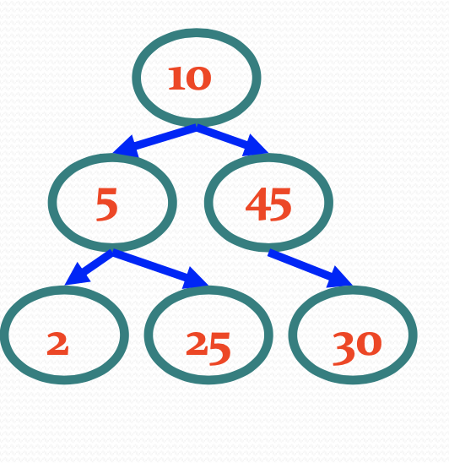
Examples

Slide 18
Searching in Binary Trees
compare ITEM with the root node N of the tree
if ITEM<N, proceed to the left child of N.
if ITEM>N, proceed to the right child of N.
repeat step (A) until one of the following occurs
we meet a node N such that ITEM=N, i.e. search is successful.
we meet an empty sub tree, i.e. the search is unsuccessful.

Slide 19
Insertion in a Binary Search Tree
Algorithm
Perform search for value X
Search will end at node Y (if X not in tree)
If X < Y, insert new leaf X as new left subtree for Y
If X > Y, insert new leaf X as new right subtree for Y

Slide 20
Deletion in Binary Tree
Algorithm
Perform search for value X
If X is a leaf, delete X
Else //we must delete internal node
Replace with largest value Y on left subtree OR smallest value Z on right subtree
Delete replacement value (Y or Z) from subtree
Note :- – Deletions may unbalance tree

Slide 21
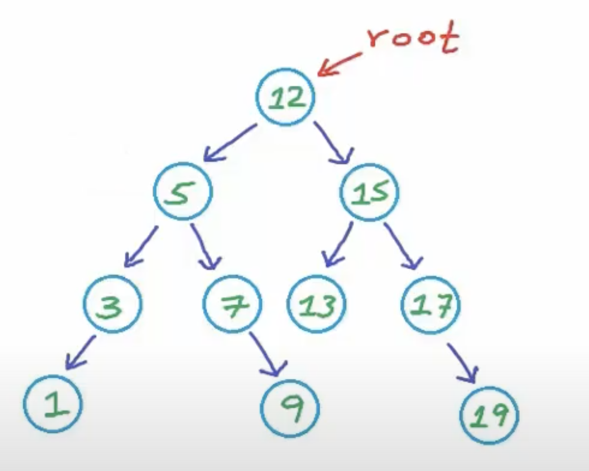

Slide 22
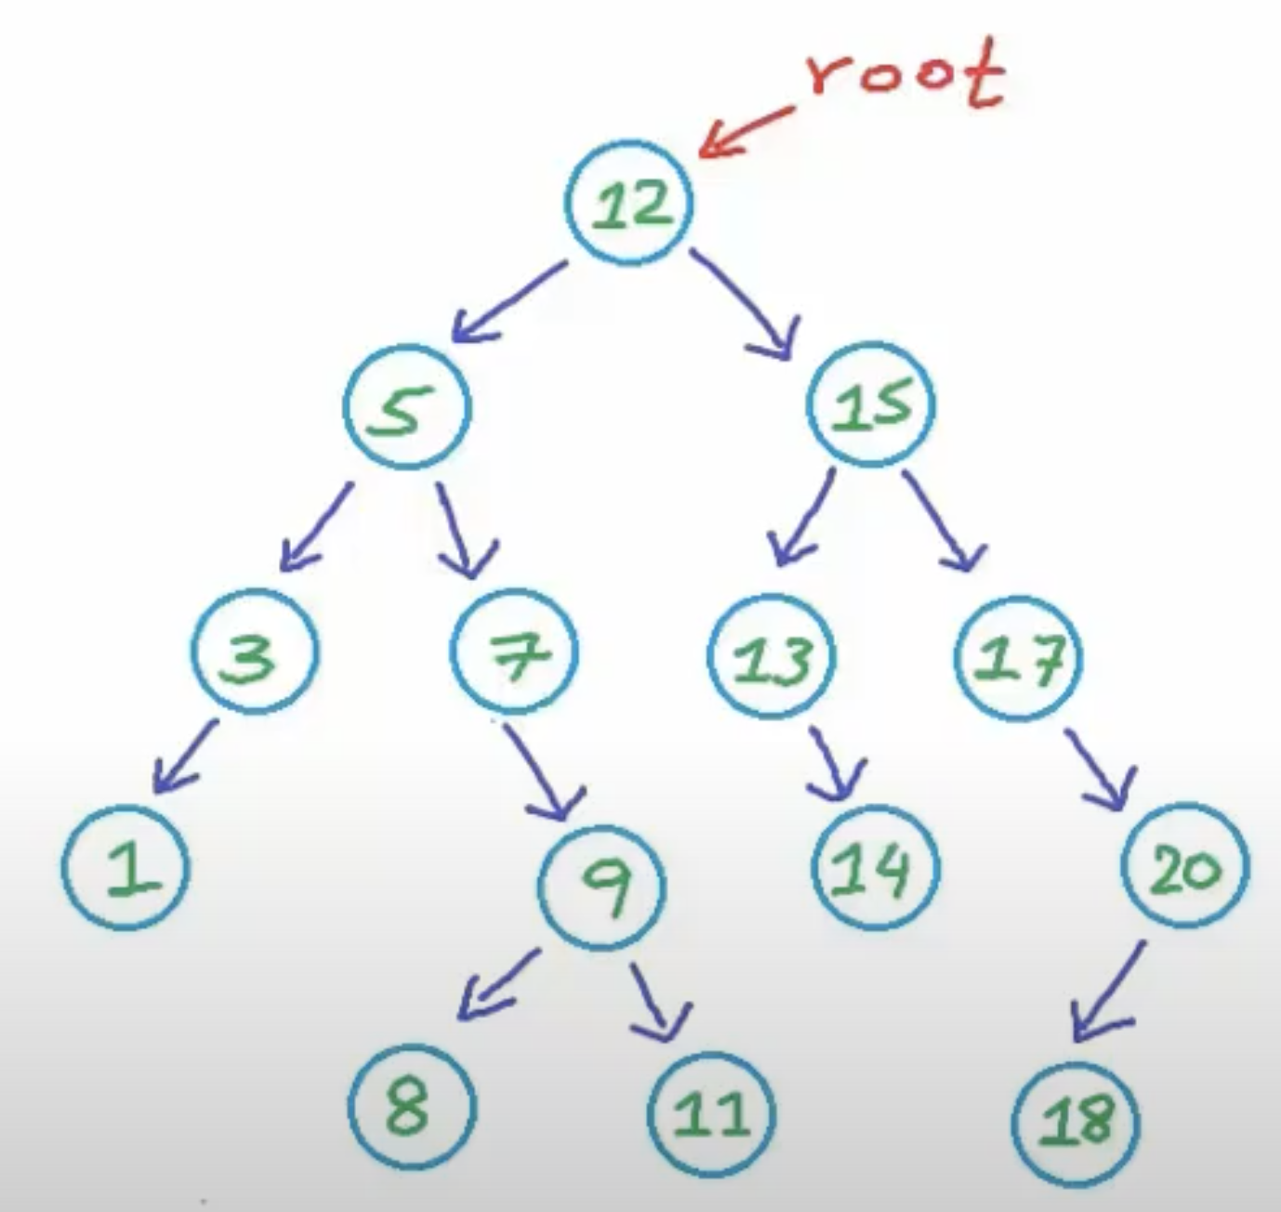

Slide 23
BINARY SEARCH TREE PERFORMANCE
Time Complexity-
Time complexity of all BST Operations = O(h).
Here, h = Height of binary search tree
Now, let us discuss the worst case and best case.

Slide 24
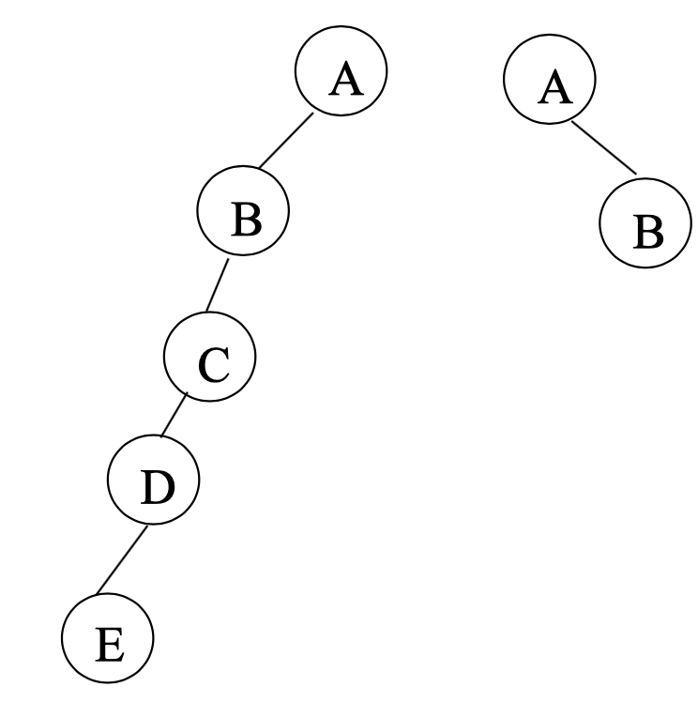
In worst case,
The binary search tree is a skewed binary search tree.
Height of the binary search tree becomes n.
So, Time complexity of BST Operations = O(n).

Slide 25
In best case,
The binary search tree is a full.
Height of the binary search tree becomes log(n).
So, Time complexity of BST Operations = O(logn).
Where n is number of nodes.

Slide 26
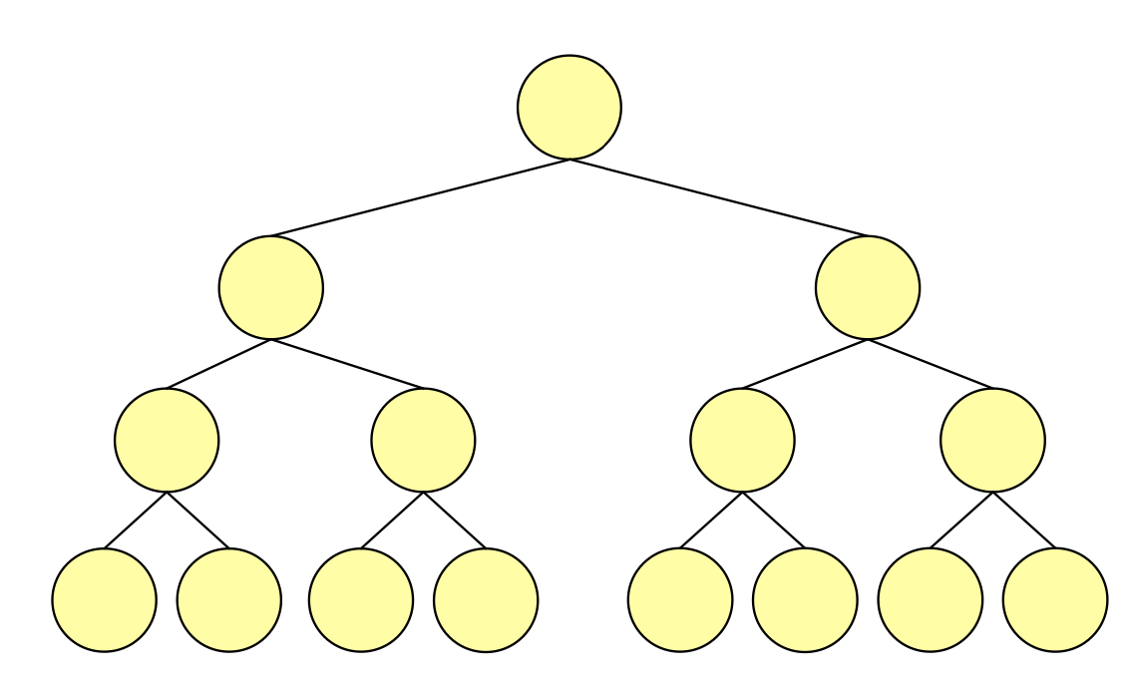
Now, considering the formula for the number of nodes in a full binary search tree: n=2^{d+1} −1
For example, the depth of a full binary search tree with 15 nodes is 3. In other words, the depth of a binary search tree with n nodes can be no less than log(n) and so the
running time of the find, insert and delete algorithms can be no less than log(n).

Slide 27
Heap
Heap is a CBT.
Max Heap:
Every node i.e parent node has maximum value or equal to all its descendent. Duplicates are allowed here.
Min Heap:
Every node i.e parent node has minimum value or equal to all its descendent. Duplicates are allowed here.

Slide 28
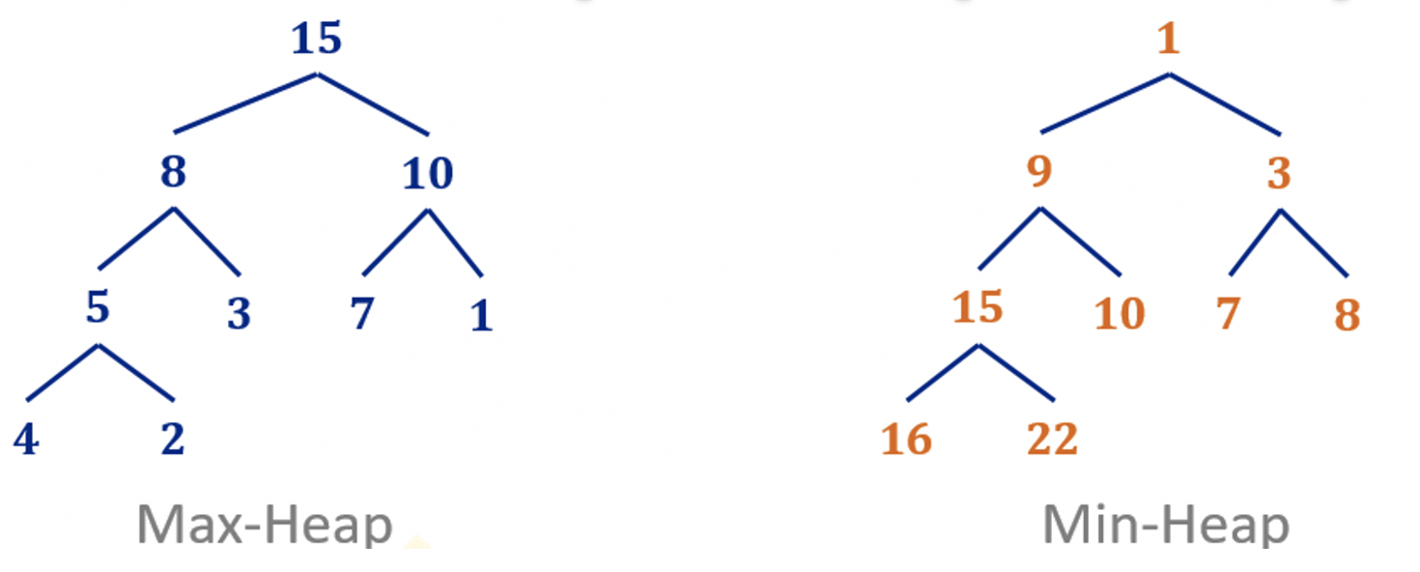
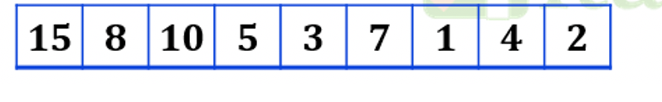
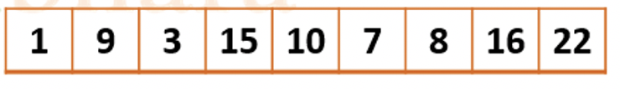

Slide 29
Insert operation in Max Heap
Insert a new as a leaf and then move upwards towards the root.
Is it heap
Make it heap
Adjustment is upward
How many swaps are required? Depends on the CB Tree i.e. log n

Slide 30
Deletion in Max Heap
Only remove the root element
last child will take place
Make it heap from the roots towards the leaf
Replace it with the greater one
First comapere children than compare the greater one with the parent and then swap
Adjust downwards
How many swaps are requuired?

Slide 31
Heap sort
Create heap
Time complexity: n elements and depend its height ie O(log n) , so time complexity is O (n log n)
Delate all the elements
Time complexity: n elements and depend its height ie O(log n) , so time complexity is O (n log n)
Time Complexity of a Heap sort is 2n log n i.e O (n log n)

